Slide 1

Auto Encoders
Keras for Deep Learning Research

Slide 2
Feedback is greatly appreciated!

Slide 3
Unsupervised Learning
Majority of the data is unlabeled!
New articles, movie reviews, Netflix user ratings, images on the internet etc.
Source: https://www.udemy.com/deeplearning/learn/v4/overview

Slide 4
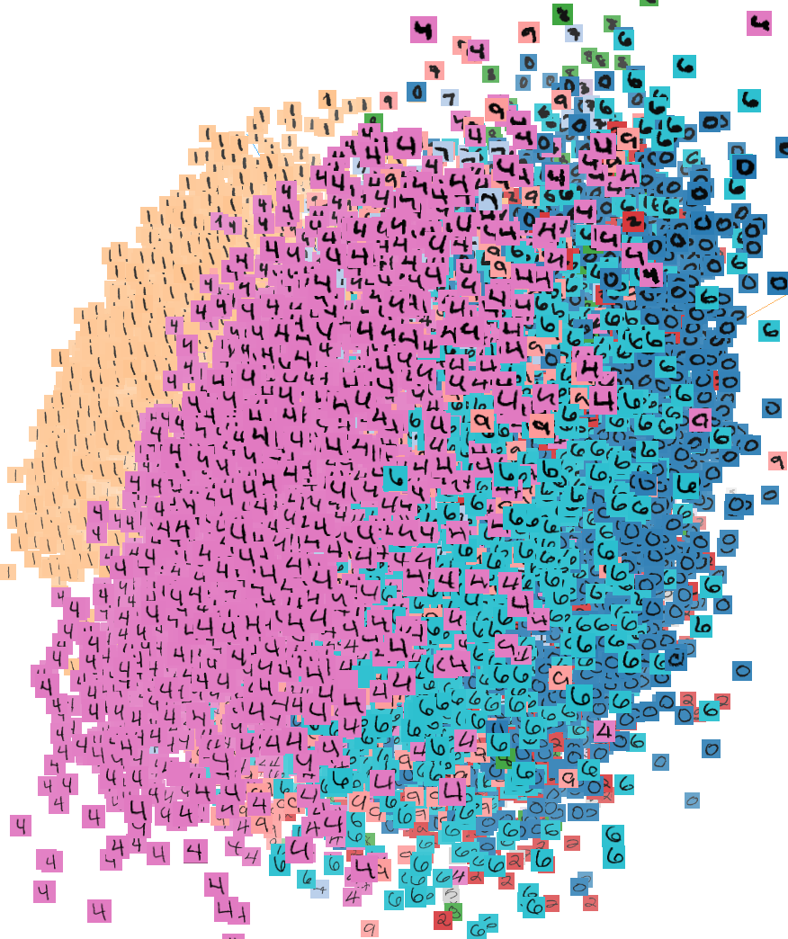
Unsupervised Learning
Unsupervised Learning
Data: X (no labels!)
Goal: Learn the structure of the data (learn correlations between features)

Slide 5
Unsupervised Learning
Applications:
Clustering the data
Compressing the data
Feature & Representation learning
Dimensionality reduction

Slide 6
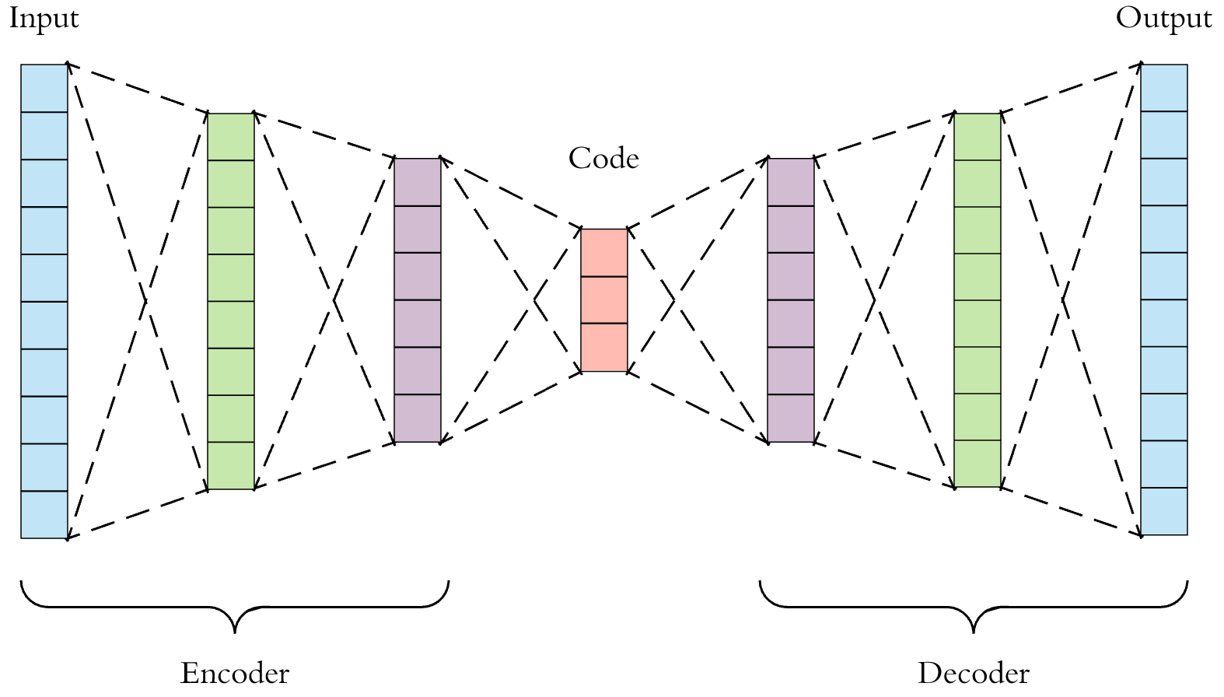
Autoencoder
Source: https://towardsdatascience.com/applied-deep-learning-part-3-autoencoders-1c083af4d798

Slide 7
Autoencoder
Autoencoder is a very simple neural network similar to a multi-layer perceptron model
It is designed to reproduce its input at the output layer
The key difference between an autoencoder and a typical MLP network is that the number of input neurons is equal to the number of output neurons
Source: https://www.udemy.com/deeplearning/learn/v4/overview

Slide 8
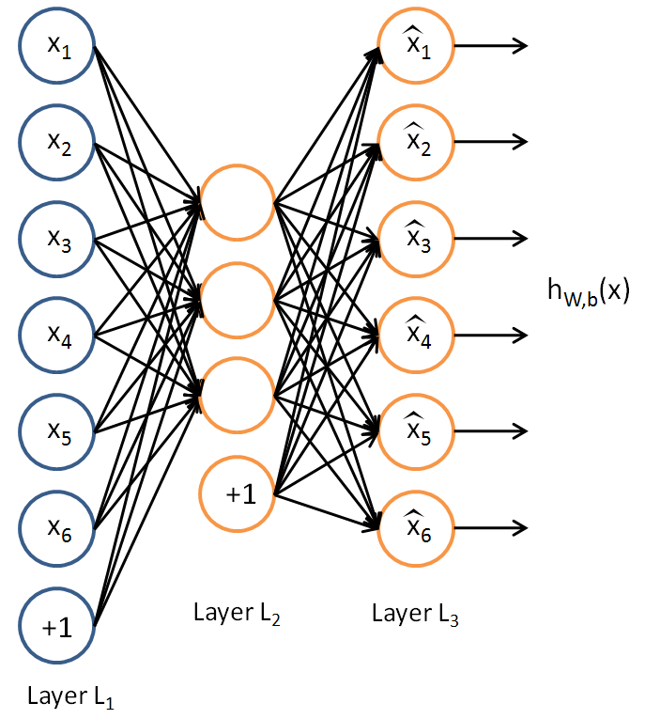
Autoencoder
An autoencoder is a neural network that has three layers: an input layer, a hidden layer and a decoding layer
The network is trained to reconstruct its inputs, which forces the hidden layer to try to learn good representations of the inputs

Slide 9
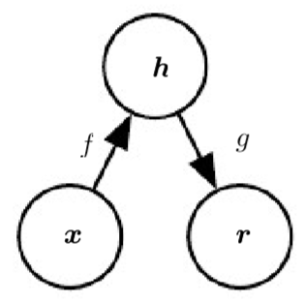
Autoencoder
The general structure of an autoencoder, mapping an input x to an output r (called reconstruction) through an internal representation or code h. The autoencoder has two components: the encoder f (mapping x to h) and the decoder g (mapping h to r).

Slide 10
Autoencoder
Encoder
Decoder
Hidden Layer
Input Layer
Reconstruction
Layer
Source: https://www.udemy.com/deeplearning/learn/v4/overview

Slide 11
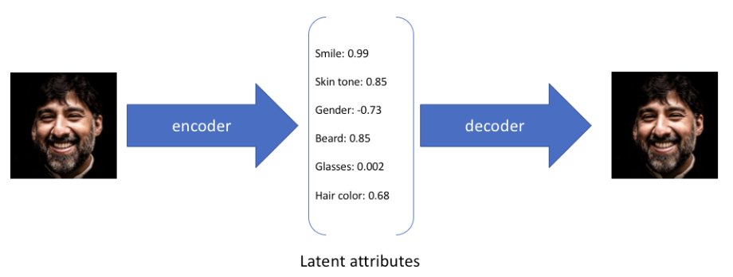
Example
Source: https://www.jeremyjordan.me/autoencoders/

Slide 12
Architecture of Autoencoders
Both the encoder and decoder are fully-connected feedforward neural networks
Hidden Layer is a single layer of an ANN with the dimensionality of our choice
The number of nodes in the Hidden layer(code size) is a hyperparameter that we set before training the autoencoder
Note that the decoder architecture is the mirror image of the encoder
The only requirement is the dimensionality of the input and output needs to be the same

Slide 13
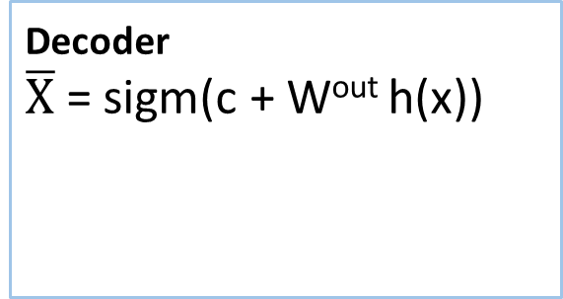
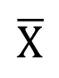
Autoencoder
c
Decoder
$\overline{X}$ = sigm(c + W^{out} h(x))
$$\overline{X}$$
Outputs
W^{out} = W^{T}
h(X)
b
Hidden
Encoder
h(x)= sigm(b + Wx)
W
Tied Weights
X
Inputs
Source: https://www.udemy.com/deeplearning/learn/v4/overview

Slide 14
Types of Autoencoders
Undercomplete Autoencoder: An autoencoder whose code dimension is less than the input dimension is called undercomplete. Learning an undercomplete representation forces the autoencoder to capture the most salient features of the training data.
Overcomplete Autoencoder: An autoencoder whose code dimension is greater than the input dimension is called overcomplete.
Regularized Autoencoders: Rather than limiting the size of the code dimension for the sake of feature learning, we can add a loss function to prevent it memorizing the task and the training data.
Source: http://machinelearninguru.com/deep_learning/tensorflow/neural_networks/autoencoder/autoencoder.html

Slide 15
Undercomplete AE VS overcomplete AE
We distinguish between two types of AE structures
Under complete AE
Over complete AE

Slide 16
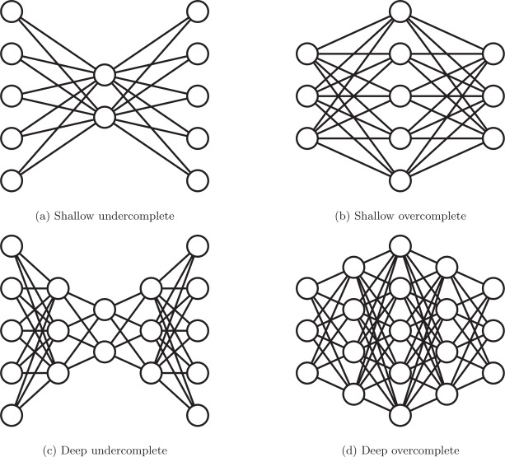
Undercomplete and Overcomplete AE
Source: http://machinelearninguru.com/deep_learning/tensorflow/neural_networks/autoencoder/autoencoder.htmlhttps://www.sciencedirect.com/science/article/pii/S1566253517307844

Slide 17
Hyperparameters of Autoencoder
Code size
Number of layers
Number of nodes per layer
Loss function

Slide 18
Types of Regularized Autoencoders
Denoising Autoencoder (DAE)
Sparse Autoencoder (SAE)
Variational Autoencoder (VAE)
Source: http://machinelearninguru.com/deep_learning/tensorflow/neural_networks/autoencoder/autoencoder.html
https://en.wikipedia.org/wiki/Autoencoder#Variations

Slide 19
Applications of Autoencoders
Dimensionality Reduction
Data Denoising
Image Compression
Feature Engineering
Representation Learning

Slide 20
Dimensionality Reduction

Slide 21
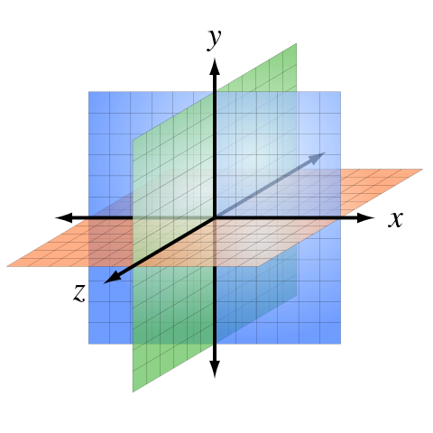
Why Dimensionality Reduction ?
In machine learning “dimensionality” refers to number of features in your dataset
Curse of Dimensionality
Number of features is very large relative to the number of observations in your dataset very difficult in training machine learning models

Slide 22
Dimensionality Reduction
Dimensionality reduction allows us to get a lower dimension representation of the data
The encoder creates new (fewer) features from the input features
Source: https://www.udemy.com/deeplearning/learn/v4/overview
Notes:
Linear Autoencoders can be used to perform a principal component analysis, which allows us to reduce the dimensionality of our data.
Keep in mind, we are not simply choosing 2 of the previous 3, but instead constructing 2 new features from the 3.
We achieve this effect by using a linear autoencoder.
Linear autoencoders perform the linear transformations by only using the weights and bias terms.

Slide 23
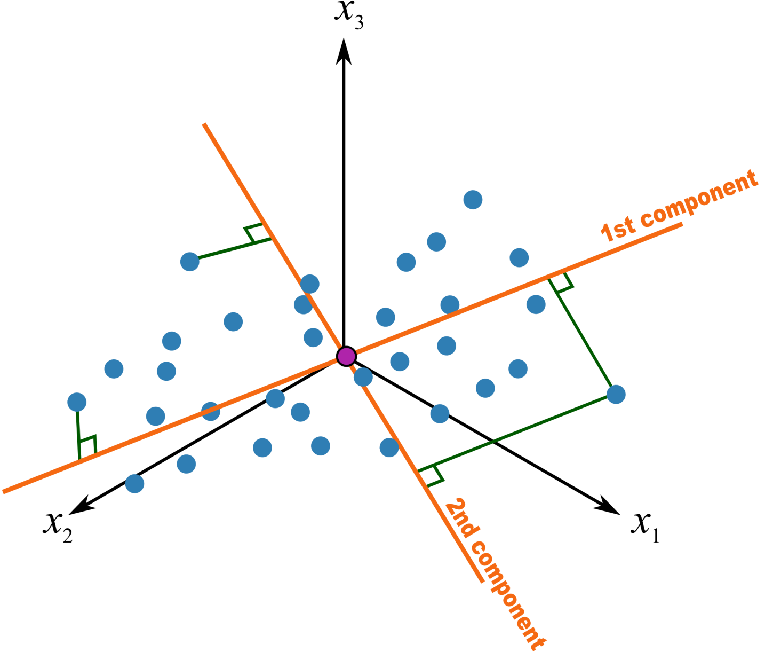
PCA – Principal Component analysis
Statistical approach for data compression and visualization
Invented by Karl Pearson in 1901
Strengths:
Fast and simple to implement
Variations and extensions to PCA
Weakness:
linear components only

Slide 24
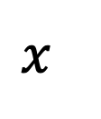
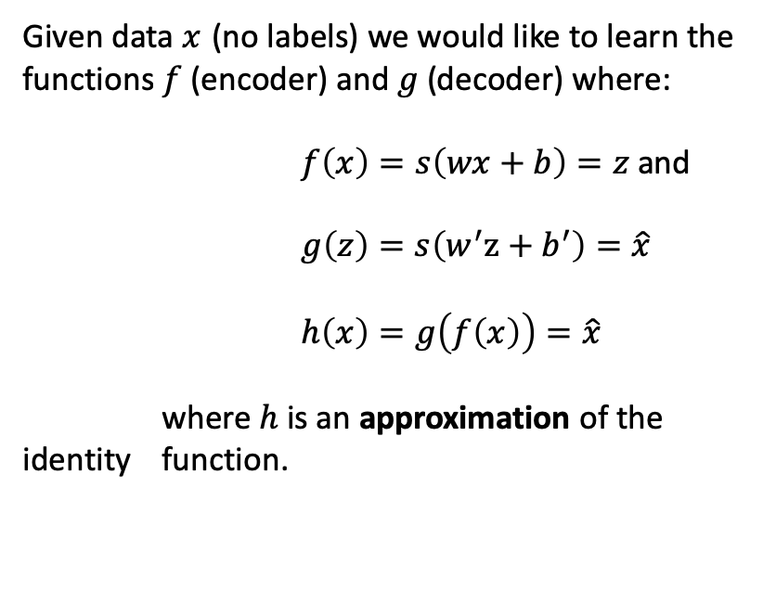
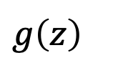
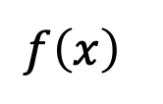
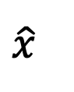
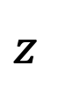
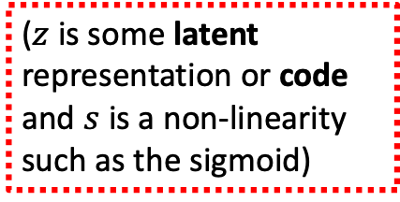
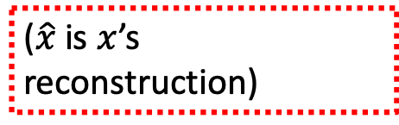
Autoencoder for dimensionality reduction
Given data $x$ (no labels) we would like to learn the functions $f$ (encoder) and $g$(decoder) where:
$f\left(x\right)=s\left(wx+b\right)=z$and
$g\left(z\right)=s\left(w^{′}z+b^{′}\right)=\hat{x}$
$h\left(x\right)=g\left(f\left(x\right)\right)=\hat{x}$
where $h$ is an approximation of the identity function.
$$z$$
$$x$$
$$f\left(x\right)$$
$$g\left(z\right)$$
$$\hat{x}$$
($z$ is some latent representation or code and $s$ is a non-linearity such as the sigmoid)
($\hat{x}$ is $x$’s reconstruction)

Slide 25
Autoencoder vs PCA
PCA is restricted to a linear map, while auto encoders can have nonlinear encoder/decoders.
A single layer auto encoder with linear transfer function is nearly equivalent to PCA, where nearly means that the W found by AE and PCA won't be the same--but the subspace spanned by the respective W's will.
Source: https://www.cs.toronto.edu/~urtasun/courses/CSC411/14_pca.pdf

Slide 26
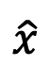
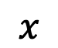
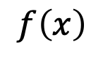
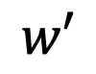
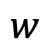
Undercomplete Autoencoder for dimensionality reduction
Hidden layer is Undercomplete if smaller than the input layer
Compresses the input
Compresses well only for the training distances
$$\hat{x}$$
$$w′$$
$$f\left(x\right)$$
Hidden nodes will be
Good features for the training distribution
Lesser (new) Features
$$w$$
$$x$$

Slide 27
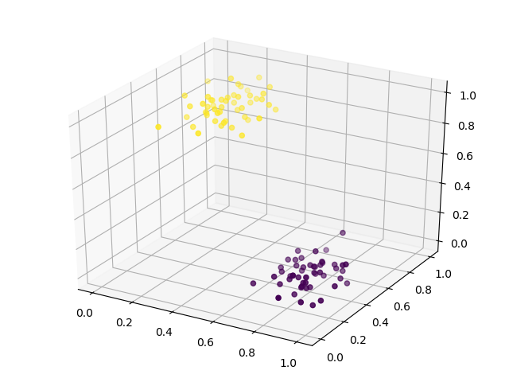
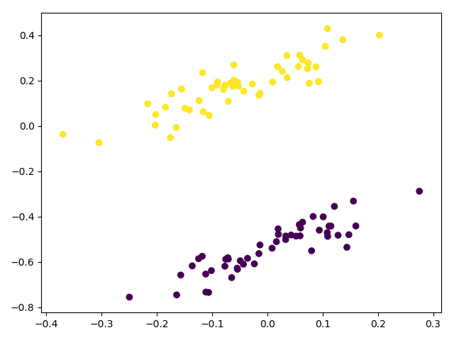
Dimensionality Reduction
We can input a 3 dimensional data point and output a 2 dimensional representation of the same

Slide 28
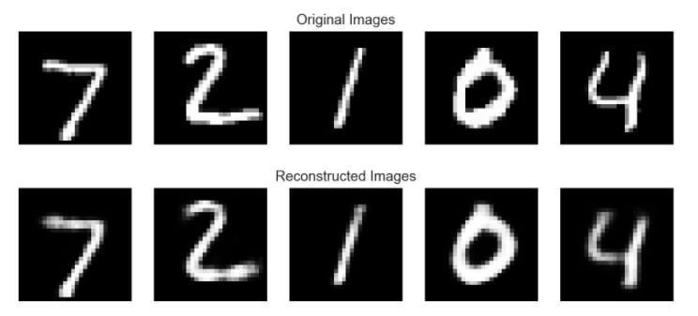
Dimensionality Reduction

Slide 29
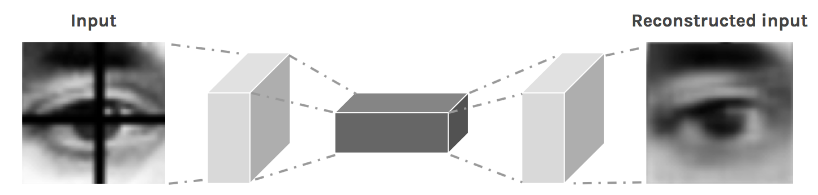
Image Reconstruction
Removes the dark cross-bar in the image

Slide 30
Denoising Autoencoder

Slide 31
Denoising Autoencoder
There is another way to force the autoencoder to learn useful features, which is adding random noise to its inputs and making it recover the original noise-free data
This way the autoencoder can’t simply copy the input to its output because the input also contains random noise
We are asking it to subtract the noise and produce the underlying meaningful data

Slide 32
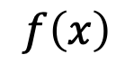
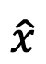
Overcomplete Autoencoder
Hidden layer is Overcomplete if greater than the input layer
No compression in hidden layer
Each hidden unit could copy a different input component
$$\hat{x}$$
$$w′$$
Strengths:
Adding dimensions is good for training a linear classifier
A higher dimension code helps model a more complex distribution
$$f\left(x\right)$$
$$w$$
Weaknesses:
No guarantee that the hidden units will extract meaningful structure
$$x$$

Slide 33
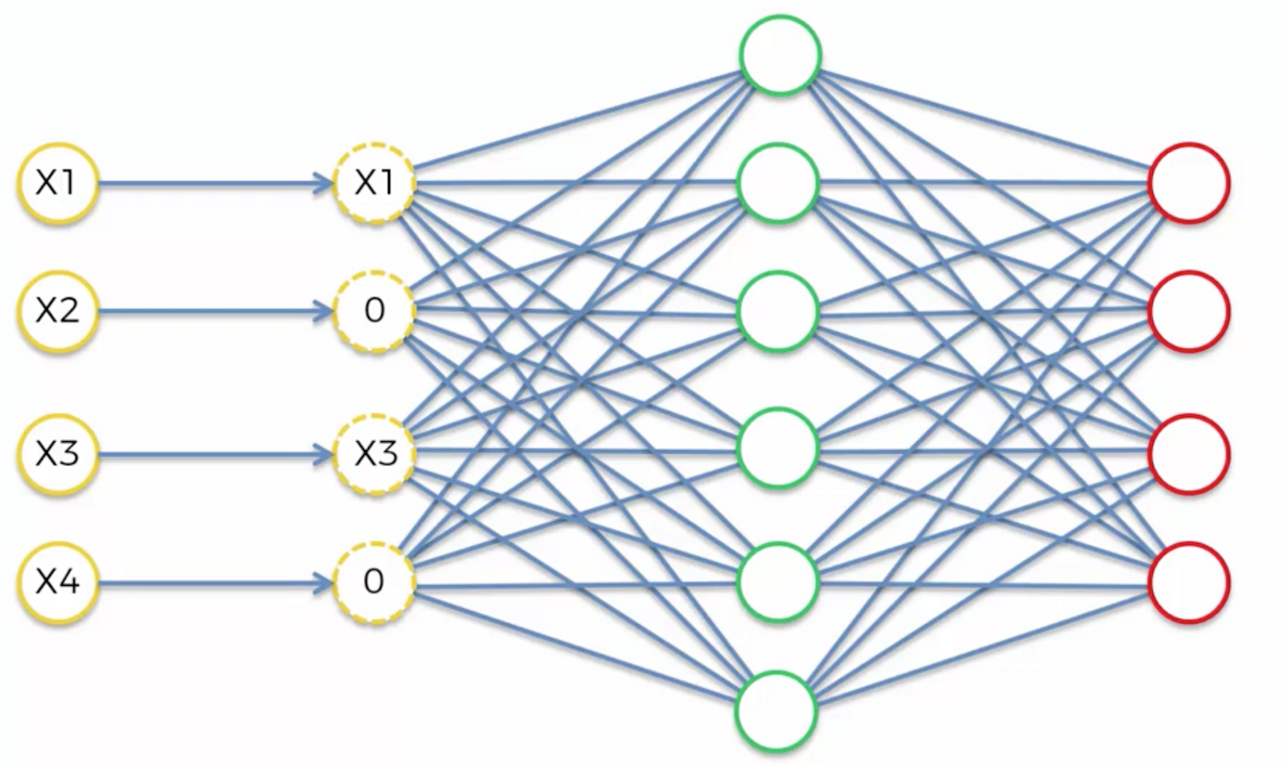
Denoising Autoencoders
Idea: representation should be robust to the introduction of noise
Random assignment of inputs to 0
Gaussian additive noise
Reconstruction x^ computed from the corrupted input x~
Loss function compares x^ reconstruction with the noiseless input x
X^
Output
Layer
X
X~
Input
Noised Input
Hidden Layer

Slide 34
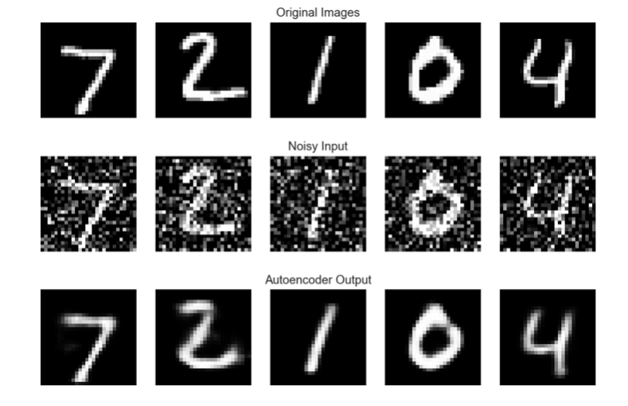
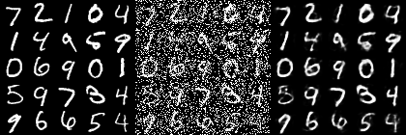
Data Denoising
Original input, corrupted data and reconstructed data

Slide 35
Sparse Autoencoder

Slide 36
Sparse Autoencoder
Is an autoencoder which has a sparsity penalty in the training loss in addition to the reconstruction error
They are usually being used for tasks such as classification
We regularize the autoencoder using a sparsity constraint such that only a fraction of the nodes would have nonzero values, called active nodes.
In particular, we add a penalty term to the loss function such that only a fraction of the nodes become active
This method works even if the code size is large, since only a small subset of the nodes will be active at any time

Slide 37
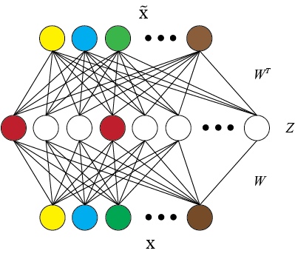
Sparse Autoencoder

Slide 38
Stacked Autoencoder
A stacked autoencoder is a neural network consisting of multiple layers of sparse autoencoders in which the outputs of each layer is wired to the inputs of the successive layer
Then the encoding step for the stacked autoencoder is given by running the encoding step of each layer in forward order: $z^{\left(l+1\right)}=W^{\left(l,1\right)}a^{l}+b^{\left(l,1\right)}$
Then the encoding step for the stacked autoencoder is given by running the encoding step of each layer in forward order: 𝑧^((𝑙+1) )=𝑊^((𝑙,1) ) 𝑎^𝑙+𝑏^((𝑙,1) )
The decoding step is given by running the decoding stack of each autoencoder in reverse order: $z^{\left(n+l+1\right)}=W^{\left(n−l,2\right)}a^{(n+l)}+b^{\left(n−l,2\right)}$
The decoding step is given by running the decoding stack of each autoencoder in reverse order: 𝑧^((𝑛+𝑙+1) )=𝑊^((𝑛−𝑙,2) ) 𝑎^((𝑛+𝑙))+𝑏^((𝑛−𝑙,2) )
Source: http://ufldl.stanford.edu/wiki/index.php/Stacked_Autoencoders

Slide 39
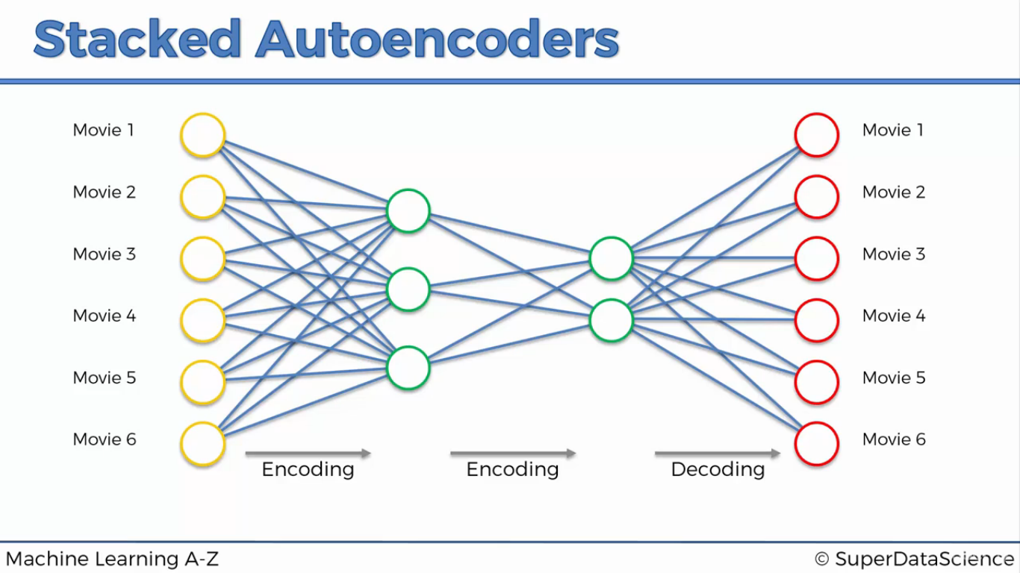

Slide 40
Variational Autoencoder

Slide 41
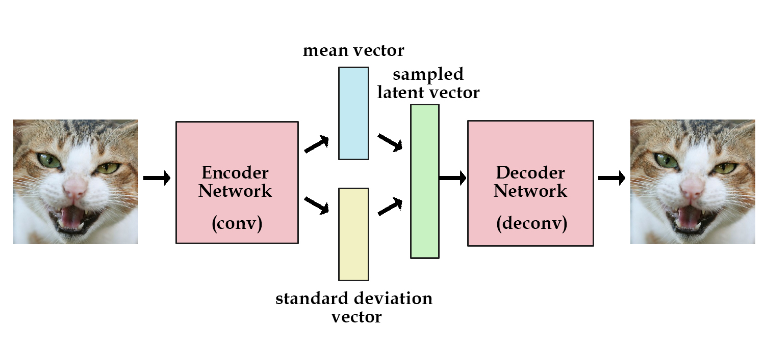
Variational Autoencoder
https://jaan.io/what-is-variational-autoencoder-vae-tutorial/

Slide 42
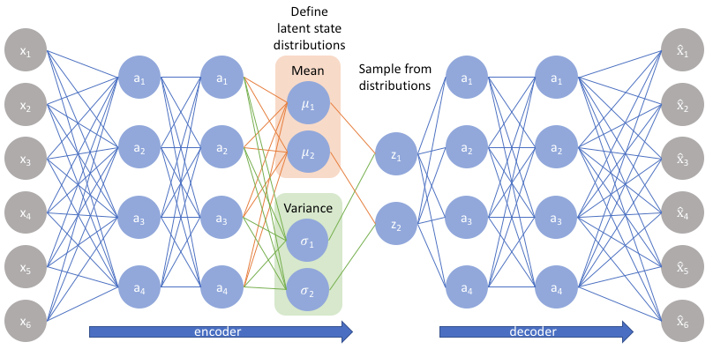
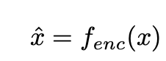
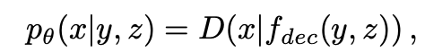
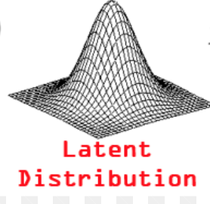
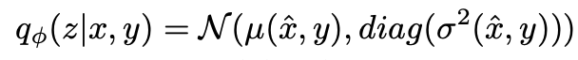
Variational Autoencoders
A variational autoencoder (VAE) provides a probabilistic manner for describing an observation in latent space
Input layer
Reconstructed Input
Source: https://www.ncbi.nlm.nih.gov/pubmed/28846608
Notes:
The encoder network formulates probability distribution for each latent attribute and
The decoder network then subsequently samples from the learnt latent attributes and attempts to recreate the original input

Slide 43
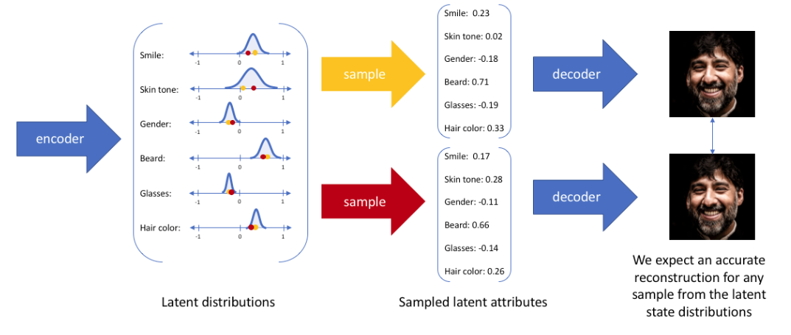
Example
Source: https://www.jeremyjordan.me/variational-autoencoders/ /

Slide 44
Use Case https://blog.keras.io/building-autoencoders-in-keras.html

Slide 45
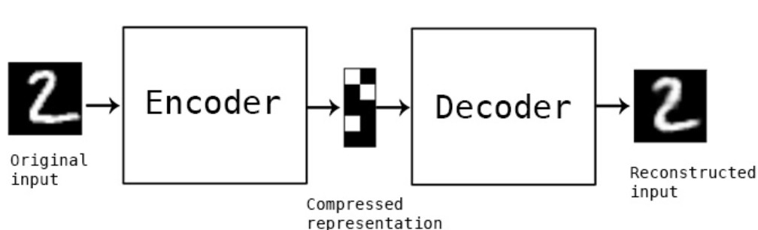
Use Case: MNIST data set

Slide 46
Creating model
encoding_dim = 32 # this is our input placeholder input_img = Input(shape=(784,)) # "encoded" is the encoded representation of the input encoded = Dense(encoding_dim, activation='relu')(input_img) # "decoded" is the lossy reconstruction of the input decoded = Dense(784, activation='sigmoid')(encoded) # this model maps an input to its reconstruction autoencoder = Model(input_img, decoded) # this model maps an input to its encoded representation encoder = Model(input_img, encoded)

Slide 47
Encoder model:
# create a placeholder for an encoded (32-dimensional) input encoder = Model(input_img, encoded)

Slide 48
Decoder model :
Encoded_input = Input(shape=(encoding_dim,))
# retrieve the last layer of the autoencoder model decoder_layer = autoencoder.layers[-1] # create the decoder model decoder = Model(encoded_input, decoder_layer(encoded_input)) autoencoder.compile(optimizer='adadelta', loss='binary_crossentropy')

Slide 49
Reading data set
First, we'll configure our model to use a per-pixel binary
Crossentropy loss and the Adadelta optimizer
from keras.datasets import mnist import numpy as np
(x_train, _), (x_test, _) = mnist.load_data()

Slide 50
Fitting model
We will normalize all values between 0 and 1 and we will flatten the 28x28 images into vectors of size 784.
x_train = x_train.astype('float32') / 255. x_test = x_test.astype('float32') / 255. x_train = x_train.reshape((len(x_train), np.prod(x_train.shape[1:]))) x_test = x_test.reshape((len(x_test), np.prod(x_test.shape[1:]))) autoencoder.fit(x_train, x_train, epochs=5, batch_size=256, shuffle=True, validation_data=(x_test, x_test)) # encode and decode some digits # note that we take them from the *test* set encoded_imgs = encoder.predict(x_test) decoded_imgs = decoder.predict(encoded_imgs)

Slide 51
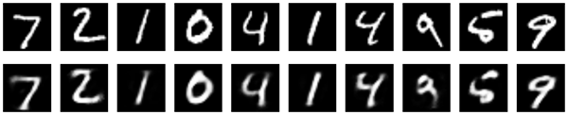
Output
Original vs reconstructed

Slide 52
References
http://www.wildml.com/2015/12/implementing-a-cnn-for-text-classification-in-tensorflow/
https://towardsdatascience.com/a-walkthrough-of-convolutional-neural-network-7f474f91d7bd

